Slide 1

KAMAT Project

Slide 2


who we are?
We are students at Faculty of Computers and Information Assiut University.
Ahmed Saad AbdulAziz IS dep.
Najm Adin Othman Sayed CS dep.
We are under the supervision of :
Dr. Ibrahim Elsemman IS dep

Slide 3

What is The problem That we solve ?

Slide 4
In short, the problem consists of:
Having a service running continuously in the background
memory limitation
Run the processor in processes that are not the target Which means more pressure on the processor
It takes longer time

Slide 5

Example

Slide 6

the solution

Slide 7

the solution
Make the program communicate with the data almost directly through a set of functions
Which leads to :-
No need for a service that runs continuously in the background
Significantly reduce memory usage
Reduce stress on the processor
Reducing response time

Slide 8

How will we implement the solution?

Slide 9
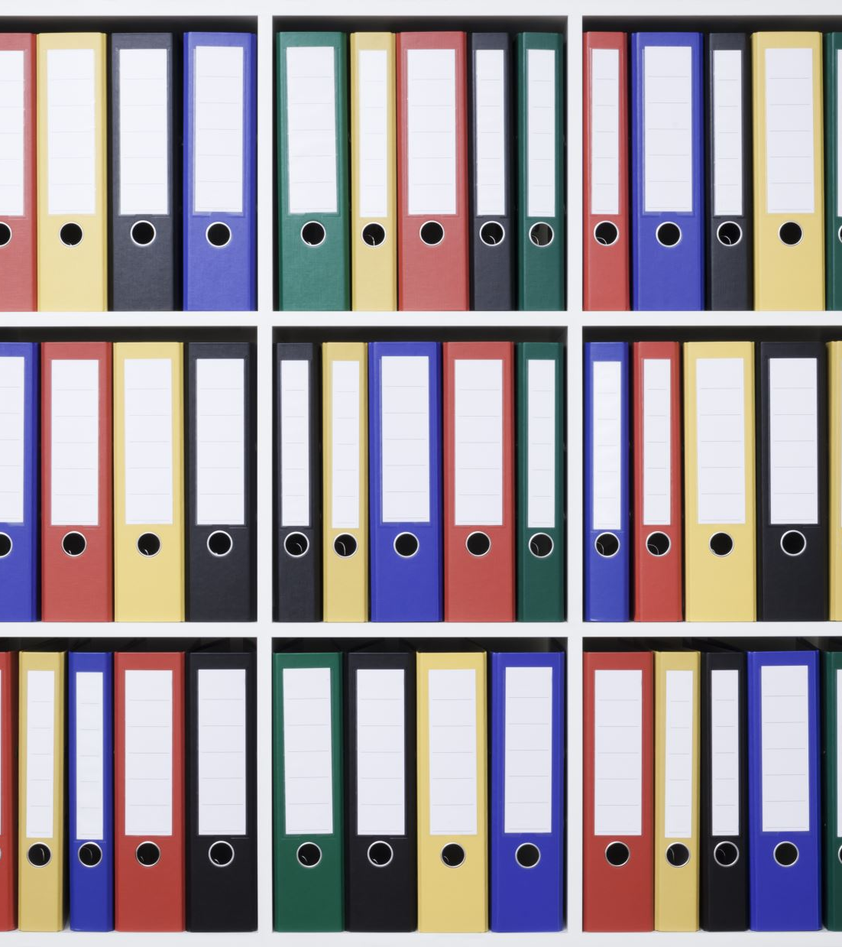
We build a tiny-system to handle almost direct with files The data is divided into Sub-flat-files and only the necessary files are read or loaded

Slide 10

We can do this by two ways!!!
1-Standalone system
2- C++ libaray

Slide 11
why c++ library not other language?
Small programs that run on devices with weak capabilities are mostly Embedded System
In fact, 90% or more of Embedded Systems' programs depend on C++ libraries

Slide 12
Kamat project

Slide 13
What is Kamat project ?
Is a tiny system to manage sub-flat-filles and data

Slide 14
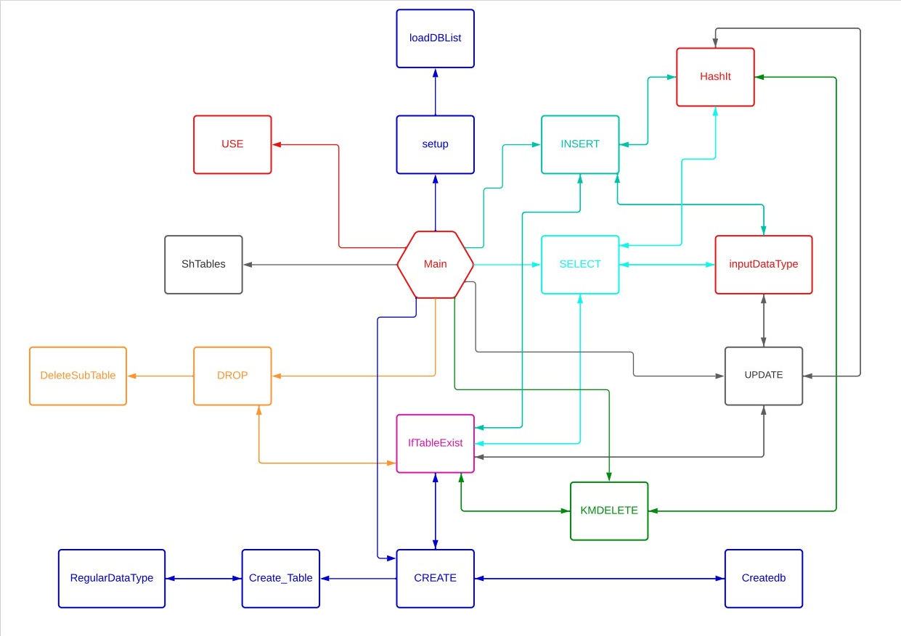
Code-design

Slide 15
Github:
https://github.com/NajmAdin/GraduationProject

Slide 16

Thanks

